Slide 1

Smart Parking System
Modeling & Design of Smart Devices
Presented By: Susan Mary Bose, Ashley Dale, Raghavan Naresh Sarangapani, Akhila Surneni

Slide 2
Table of Contents
What is Smart Parking System ?
Solution
Assumptions
Implementation
Smart Device design
Workflow
Design
Kalman Filter
Challenges
Future work
References

Slide 3
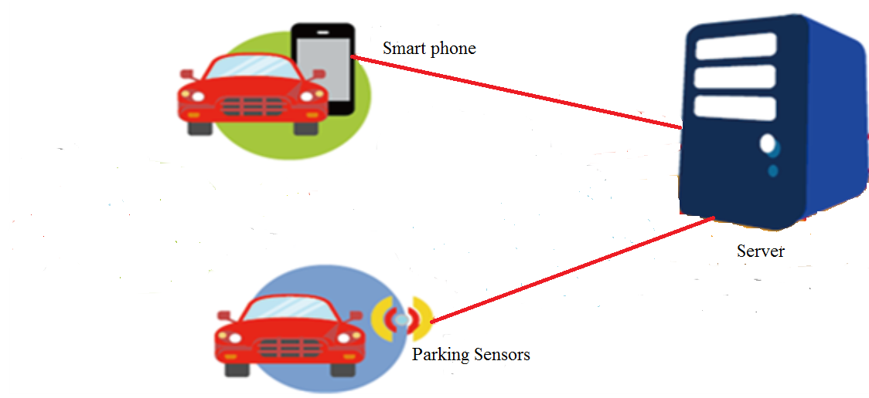
What is Smart Parking System ?
Smart Parking System is an integrated system to organize cars in public spaces.
The motivation of this project is to help users (drivers) save their time while parking.

Slide 4
Solution
Goal: Implement outdoor parking space tracking system
Current parking applications use two methods:
Indoor Systems utilize Wi-Fi /cellular network to track available parking spaces
Outdoor Systems utilize cameras, RFID tags, & other sensor devices
Both systems require complex hardware and are difficult to implement
Solution : Build an android application that utilizes sensors already included in the phone to track parking positions

Slide 5
Assumptions
Phone is inside car, calibrated to a fixed gyroscope orientation that matches the orientation of car
The user presses start button to start monitoring movement (HCI)
Test parking environment consists of 4 parking spots distant from each other
Parking areas are pre-determined by a database stored on off-site processor. When a user enters an area, the database uses context awareness to determine which parking spots are available to that user

Slide 6
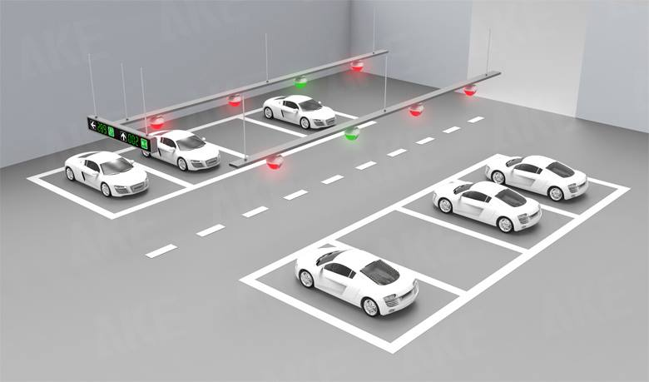
Implementation
Currently on entering the parking lot, the user presses the Start button.
This calibrates the sensors and starts the sampling.
In the future this can be done automatically at the parking entrance.
3
4
2
1

Slide 7
Implementation
File is downloaded from server to a PC application using a fat-thin server-client implementation (phone = thin; PC = fat)
Data is passed through Kalman filter to smooth values and remove errors.
Data is sampled to find velocity direction, then integrated to determine distance traveled in that direction
Based on direction and distance, algorithm decides which parking spot, the car has been parked into. (P1/P2/P3/P4)
This position can be stored in the PC and shown to the next user.
As more users join the system, a distributed model can be developed

Slide 8
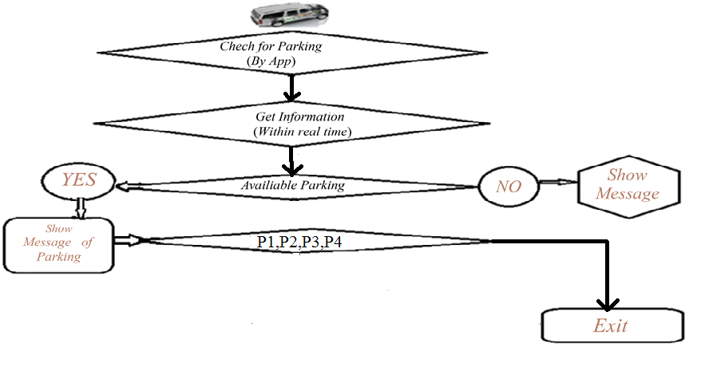
Work Flow

Slide 9
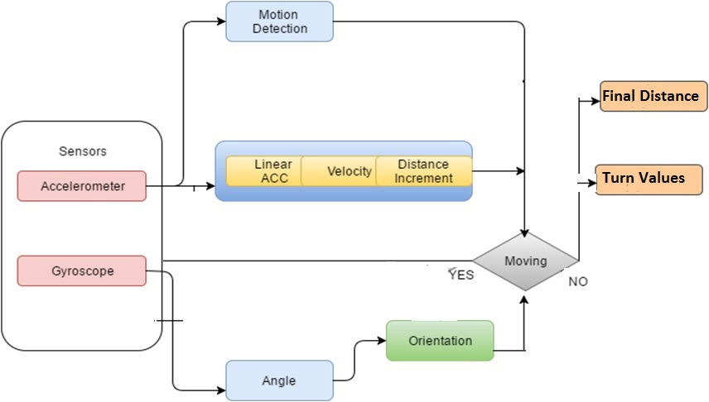
Design

Slide 10
Kalman Filter
The Kalman filter is used to remove the noise in the accelerometer values and make them uniform.
Simple form of Kalman filter is used
New State = A*Alpha Values*X + C
New State is the values to be predicted.
Alpha value is multiplication factor and varies from each level..
X is the predicted values.
C is co variance matrix.

Slide 11
Challenges
Implementing the covariance matrix with the initial values
Sampling Gyroscope and Accelerometer data at the same time, as its not possible practically
Calibration issues
Data storage
Algorithmic speed Vs actual parking

Slide 12
Future Work
Improve accuracy for better detection of the adjacent parking spots.
Include Indoor parking along with the existing system.
Automatic start of the application without user having to press “Start” and suggest parking spots nearby by making use of current location of the user.

Slide 13
Future Work
Improve the functionality of the application.
Database of the parking system to know the placement of the parking lots.
Improve Kalman filter properties to increase accuracy of prediction.

Slide 14
References
Vincent, David. "Accurate Position Tracking Using Inertial Measurement Units“, PNI Whitepaper (2013).
Scarlett, Jim. "Enhancing the Performance of Pedometers Using a Single Accelerometer”, Analog Devices, AN900.
Shala, Ubejd. Rodriguez, Angel. ”Indoor Positioning using Sensor-fusion in Android Devices”, School of Health and Society (2013)
Foxlin, Eric. “Pedestrian Tracking with Shoe-Mounted Inertial Sensors”, Intersense (2005)
Paul.S, Anindhya, Wan.A, Eric, “RSSI-Based Indoor Localization and Tracking Using Sigma-Point Kalman Smoothers”, IEEE Selected topics in Signal Processing (2009)
"Example Kalman Filter - Efficient Java Matrix Library", Ejml.org, 2016. [Online]. Available: http://ejml.org/wiki/index.php?title=Example_Kalman_Filter. [Accessed: 08- Dec- 2016].
"Filtering Sensor Data with a Kalman Filter", Interactive Matter Lab, 2009. [Online]. Available: http://interactive-matter.eu/blog/2009/12/18/filtering-sensor-data-with-a-kalman-filter/. [Accessed: 08- Dec- 2016].
"Java Code Example", Programcreek.com, 2016. [Online]. Available: http://www.programcreek.com/java-api-examples/index.php?source_dir=Rubik-Cube-Wizard-master/Rubik%20Solver/src/org/ar/rubik/CubePose.java. [Accessed: 08- Dec- 2016].
D. Kohanbash, "Filtering Sensor Data with a Kalman Filter", Interactive Matter Lab, 2014. [Online]. Available: http://interactive-matter.eu/blog/2009/12/18/filtering-sensor-data-with-a-kalman-filter/. [Accessed: 08- Dec- 2016].

Slide 15

Any Questions ???

